Slide 1




19”RACK MOUNTABLE FOLDABLE DISPLAY KB
Preliminary Design Review
Space
Telecom
Defense
Automation

Slide 2
HARDWARE OVERVIEW
ULH1853-A --- 18.5” TFT LCD Display
SB-87-TP-USB --- 87 keys Keyboard With Touch pad
EF-1B006B02E-C02 --- EMI-RFI Filter
ELP75 --- AC to DC Power supply
H8550VBACA --- ON /OFF Switch
LXR3612GD --- Power LED (Green)
DBPL-AC-I/IP-18-01 --- Common Mode & Line Filter

Slide 3

ULH1853-A Specifications
18.5” TFT LCD Display
Brightness 500 cd/m²
Resolution Supports upto 1920x1080
Aspect ratio 16 : 9
Contrast ratio 1100:1
Viewing angle 89/89/89/89
Display colors 16.7M
LED Backlight
Interfaces VGA, DP
Operating Temperature -20 ~70 ˚C
Input Power DC 12V

Slide 4
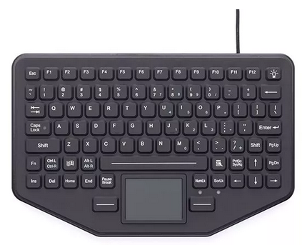
SB-87-TP-USB
87 Keys with touch pad
USB Based connection
Silicon Rubber
Red Backlit Keys
12 Function Keys
Ultra-Thin Design
Cable length : 55" +/- 2" (straight USB)
POWER : 200mA@5V
      Operating Temperature -40 ~70 ˚C

Slide 5
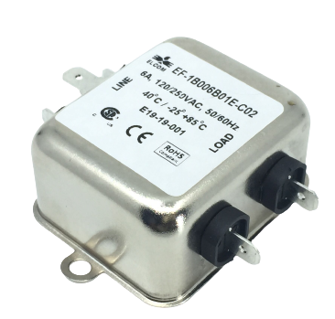
EF-1B006B02E-C02 Specification
EMI/RFI Filter
Filter category: Single phase
Mounting: Chassis
V/A rating: 6 Amp,10 Amp & 15 Amp, 120/250VAC, 50/60Hz
Operating Temperature: -25° to +85°C
Operating Frequency : 50/60Hz
Insulation resistance at 500 VDC for 60 sec ± 5 sec. (by shorting L & N terminals & w.r.t. earth) : Min. 300MΩ

Slide 6
MIL-CIRCULAR CONNECTORS
D38999-20WA-98PN --- Power Circular connector
D38999-26WA-98SN --- Power Circular matting
M85049/38-09W --- Backshell for Matting Connector
D38999-33-W9R --- Dust Cap for Power Connector
USB FTV 21G --- Panel mount Circular USB connector
USB FTV 6G --- USB Mating Connectors
USB FTV C2G --- USB Dust Cap

Slide 7
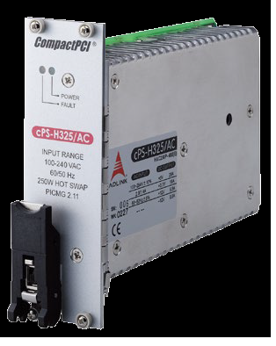
cPS-H325/AC SPECIFICATION
3U CompactPCI® 8HP form factor
250 W DC output
Hot swappable
Input Voltage: 90-264 ± 10% VAC
Input Frequency: 47-63 ±5% Hz
Input Current: 2.8 A @ 115 VAC
1.4 A @ 230 VAC
Output Voltage/Current
5V: Typ. 25.0A, Max. 33.0A
3.3V: Typ. 18.0A, Max. 33.0A
+12V: Typ. 5.0A, Max. 6A
-12V: Typ. 0.5A, Max.1.5A
Status LED:
Green: Valid I/P Voltage
Amber: Critical fault
Operating Temp: 40 °C to +70 °C
Storage Temp: -45˚C to +85˚C

Slide 8
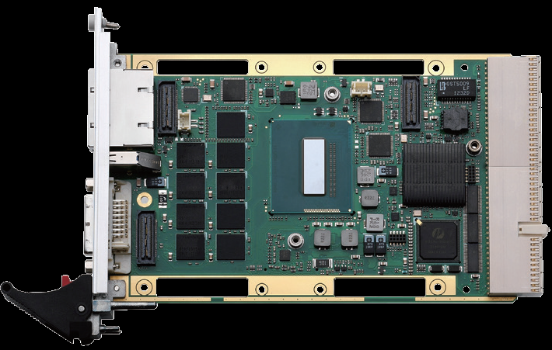
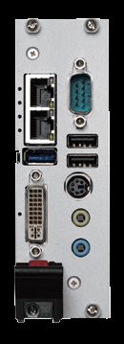
cPCI-3510BLD/5700E/M16 SPECIFICATION
Intel® Core™ i7-5700EQ Processor 2.6GHz, 3.4GHzTurbo
8GB DDR3L-1333 SDRAM ECC soldered
Mobile Intel® QM87 Chipset
DVI-I port on faceplate, VGA switchable to J2 (RTM) by BIOS setting
Reslution supports up to QXGA 2048x1536 pixels@75Hz, 32-bits
2x Gibabit Ethernet controllers
1x USB 3.0 port
2 x USB 2.0 port
CFast socket and SATA connector
PS/2 Keyboard/Mouse combo port
Line-in and Line-out port
1 x DB-9 RS-232/422/485
Operating Temperature: -20°C to +70°C
Storage Temperature: -50°C to +100°C

Slide 9
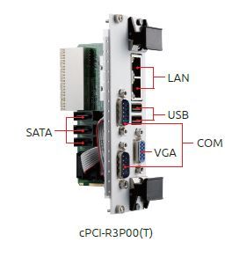
cPCI-R3P00 SPECIFICATION
8 HP Rear I/O module
1 x VGA port
2 x USB 2.0
2 x COM ports
3 x SATA ports
2 x Ethernet ports
Board Size: 100mm x 50mm

Slide 10

DGS25-01TD81BWAQC-J27 SPECIFICATION
2.5” SATA SSD
SATA III 6Gb/s
Flash Type: MLC
Max. Power Consumption: 6 W
Sequential R/W : 520 / 480 MB/s
Dimension (WxLxH): 69.85 X 100.0 X 6.9 mm
MTBF: 3 million hours
Storage Temperature: -55°C ~ +95°C
Operational Temperature: -40°C ~ +85°C

Slide 11
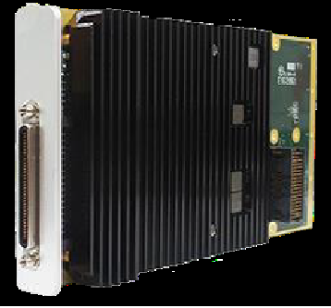
cPCI-XMCe SPECIFICATION
GPU: NVIDIA GeForce GTX 1050Ti
GPU: Clock 620 MHz
NVIDIA® CUDA™ Cores 768
Max. Digital Display Support: 3840x2160
Display Interface: 4* DVI or 4* HDMI via VHDCI
Floating Point Performance: 952.32 GFLOPS
Memory Size: 4GB GDDR5
Memory Clock: 7.0 Gbps
Memory Interface Width: 128 bit
Memory Bandwidth (GB/sec): 112
Max. Board Power Consumption (W): 30 W

Slide 12
DSL – RKVM18-97TP SPECIFICATION
DVI

Slide 15
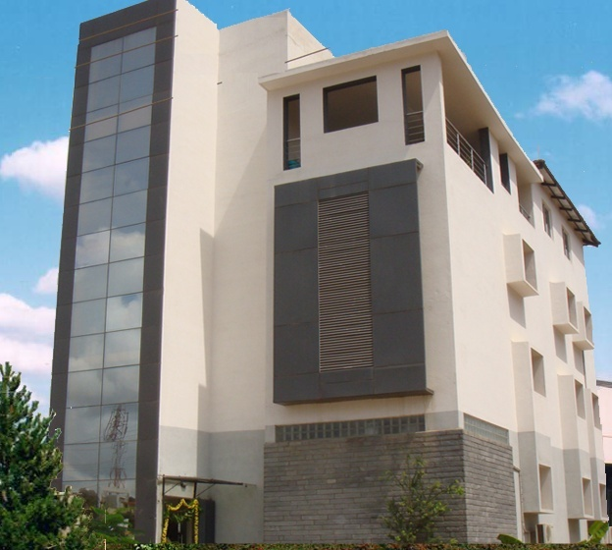

Contact Us …
Corporate Office :
Datasol Bangalore Private Limited
“Datasol House”, #793, Stilt & 1st Floor, Vyalikaval HBCS, (Behind BEL corporate office), 17th Cr. Road, Veeranna Palya, Nagawara, BANGALORE – 560 045
Ph: 080-2544 0642 /643 Fax: 080-2544 0644
E-Mail:
sales@datasolindia.com
support@datasolindia.com
Branches:
Hyderabad Trivandrum New Delhi
www.datasolindia.com

Slide 16



